Slide 1
Real State: Belgian Market
Hui, Mustafa, Georgina
July 15, 2024

Slide 2

What determines the price of real estate in Belgium?
The annual inflation rate for house prices amounts to 3.1% in the first quarter of 2024(1)
Location
Number of Facades
Year of Construction
https://statbel.fgov.be/en/themes/housing/house-price-index

Slide 3
Disponibility

Slide 4
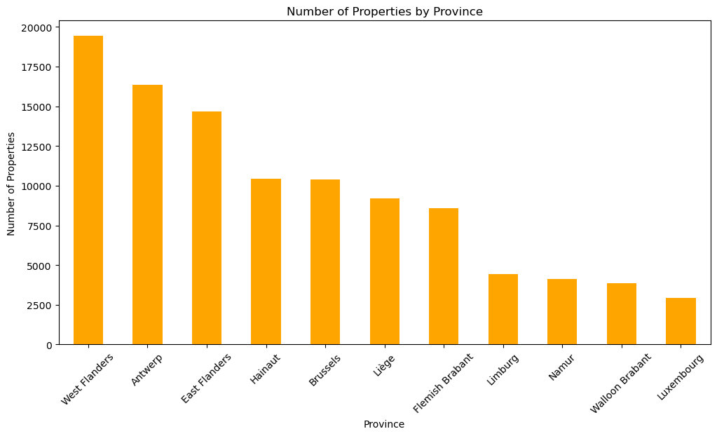
Distribution of Properties
Bruge: 5824
Total: 104472
Antwerp:
9081
Gent:
5055
Brussels:
10411
Liege:
6052

Slide 5
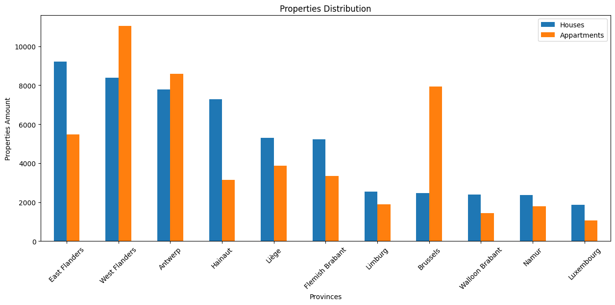
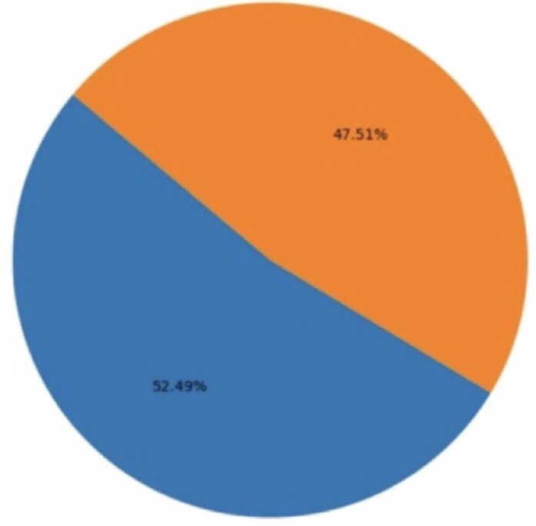
Distribution of Properties
Appartments:
47.51%
Houses:
52.49%

Slide 6
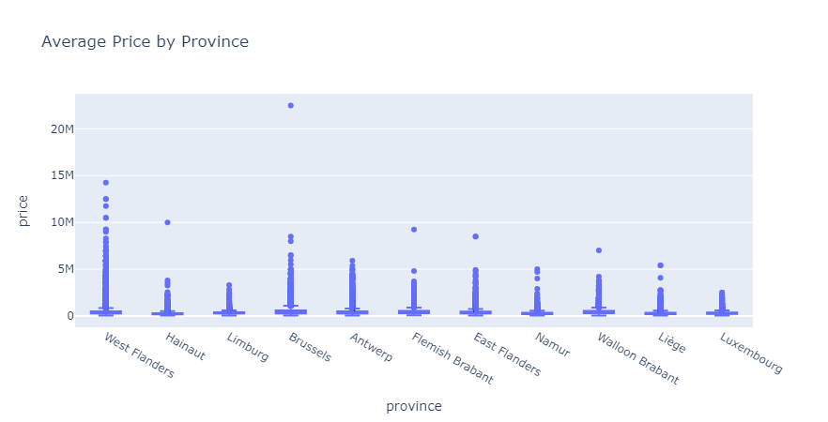
Price average by province

Slide 7
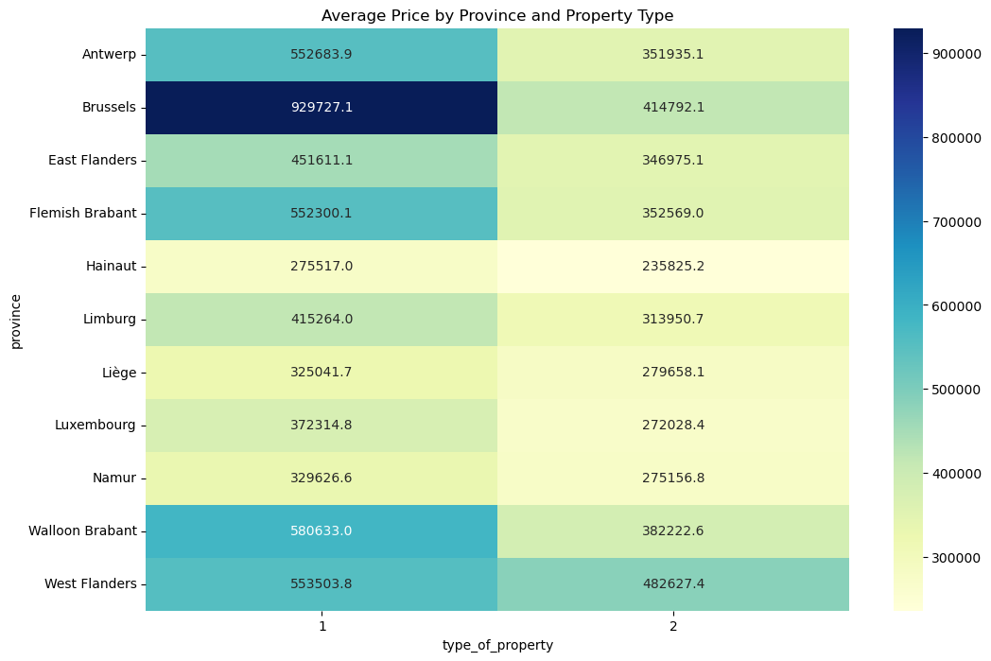
Price average by province and property type

Slide 8
Features that influence the price

Slide 9
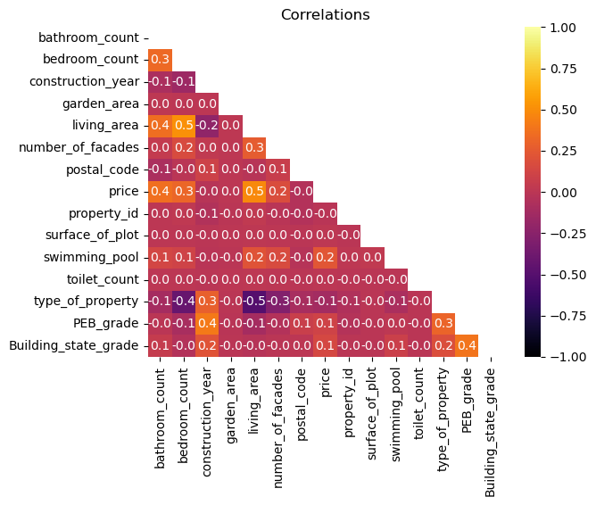
Price correlation

Slide 10
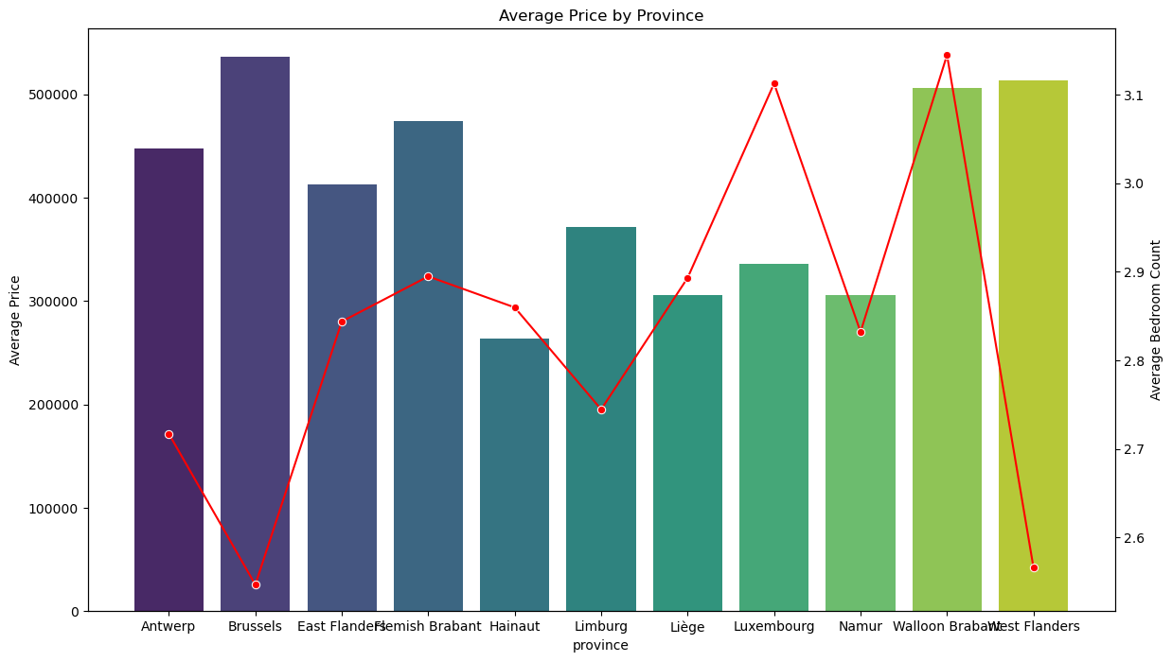
Average price by province and number of rooms

Slide 11
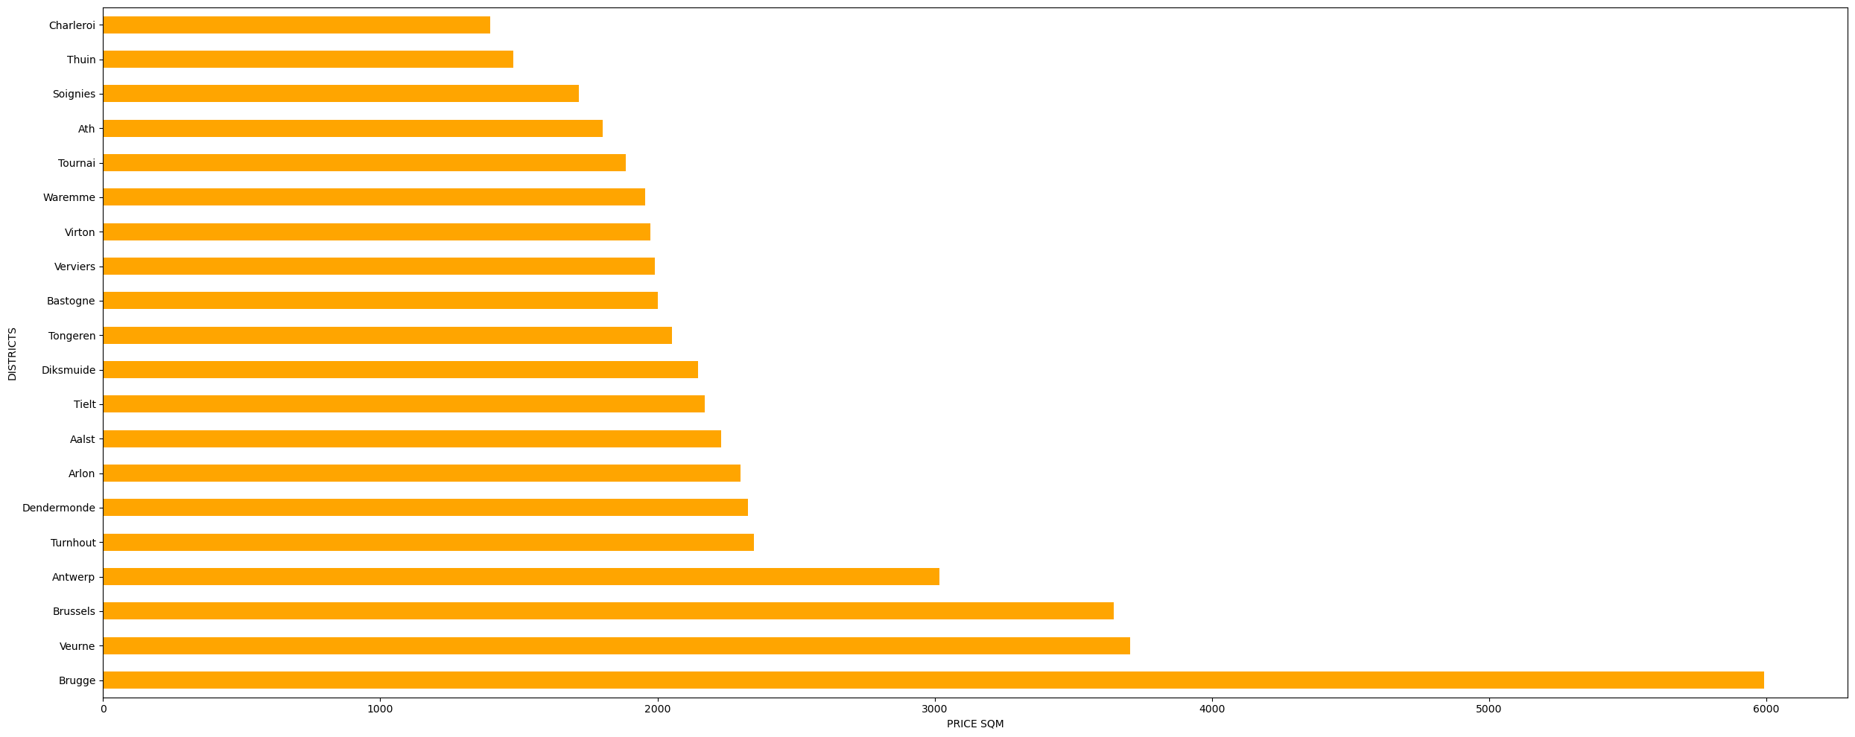
Price per square meter in the Belgian districts
(calculated with inthernal information)

Slide 12
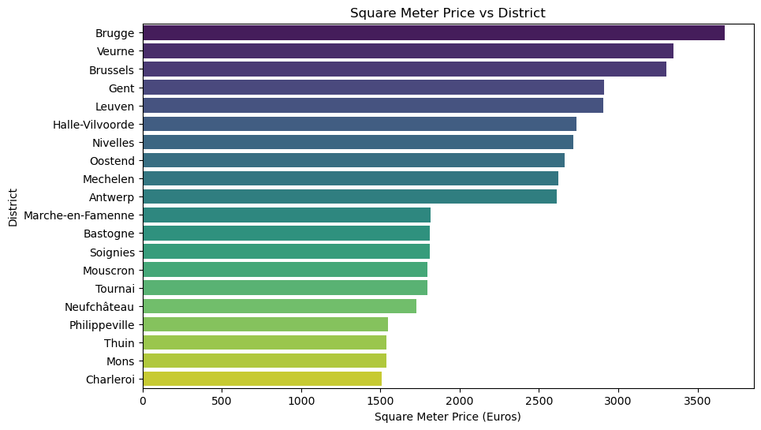
Price per square meter in the Belgian districts
(calculated with external information)

Slide 13
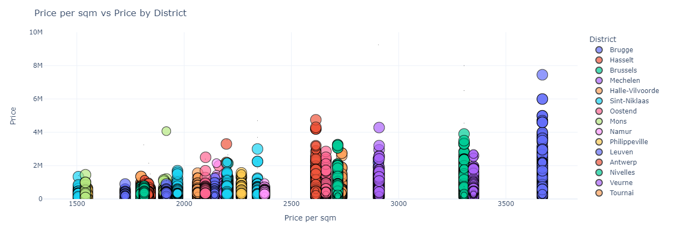
Price vs Price per square meter in the Belgian districts

Slide 14
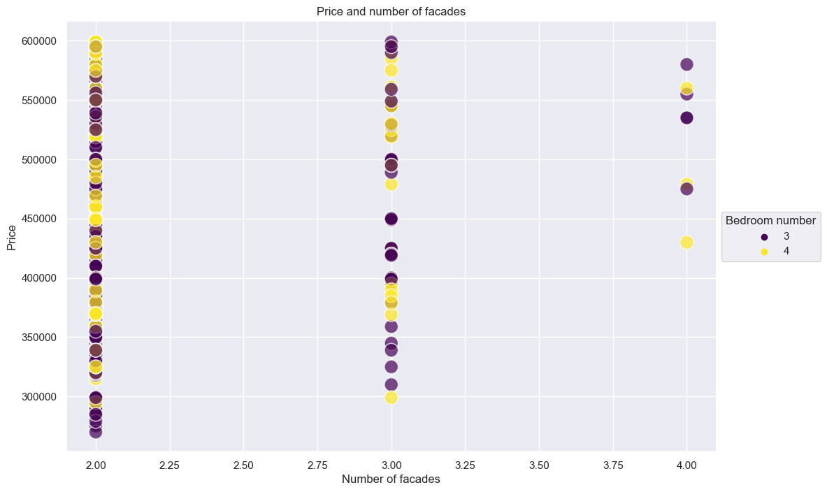
Price vs number of facades in houses with similar number of rooms

Slide 15
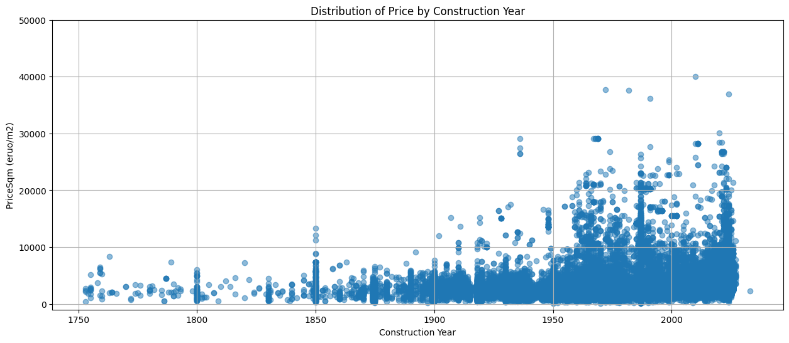
Distribution of Price per Square Meter by Construction Year

Slide 16
Next tasks
What determines how much a property will cost in Belgium?
Use the main influencing traits to train the ML model
Predict the prices of a property in Belgium to answer:
Is it a good time to buy/sell a house/apartment in Belgium?
Price climbing (%)
Either for investment or for having a patrimony?
Renting
Buying

